Slide 1
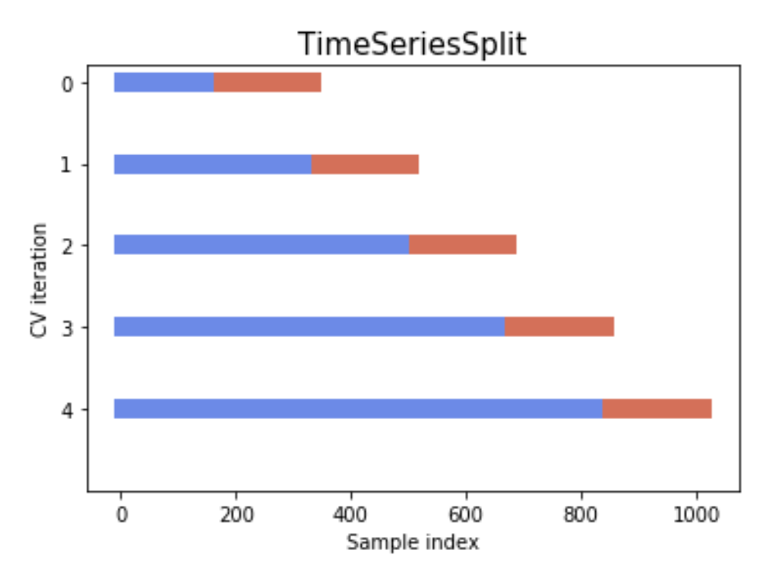
Task #1
Train
Training data
Well #2
Well #3
Models with their best hyperparameters
Mini batch data
Well #4
Test data
Test
Well #3
Mini batch data

Slide 2
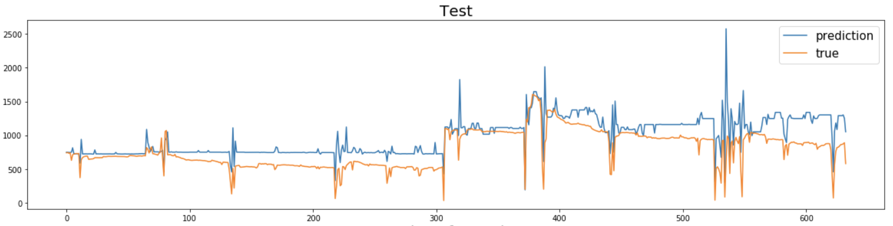
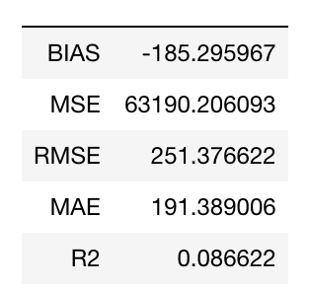
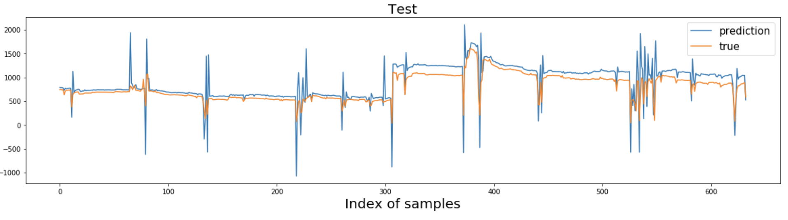
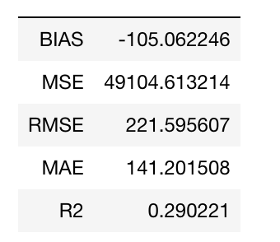
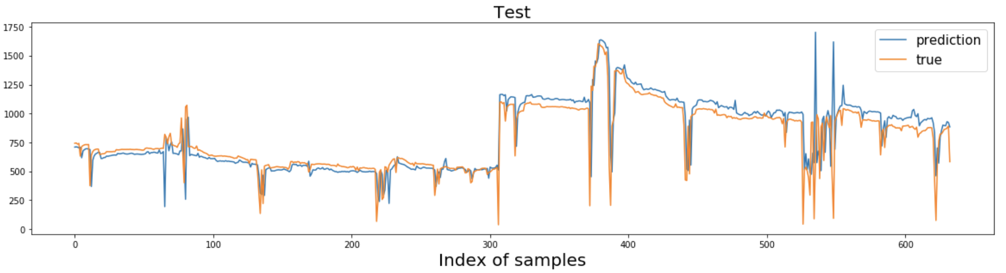
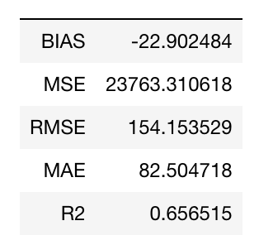
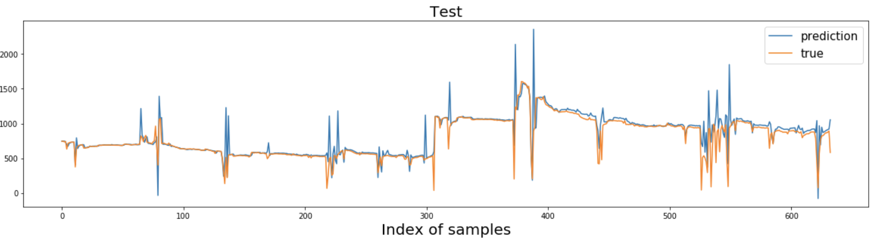
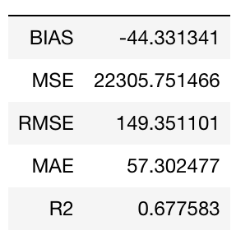
Task #1
For oil
RF
{'max_depth': 11, 'max_features': 'sqrt', 'min_samples_leaf': 1, 'min_samples_split': 2}
{'alpha': 0.9, 'fit_intercept': False, 'l1_ratio': 0.1, 'max_iter': 100}
EN
NN
{'activation': 'relu', 'alpha': 0.01, 'hidden_layer_sizes': 128, 'learning_rate_init': 0.001}
SVR
{'C': 10000.0, 'gamma': 'auto'}

Slide 3
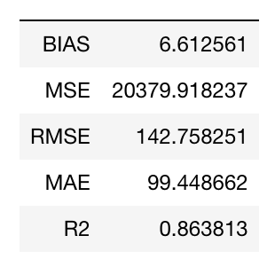
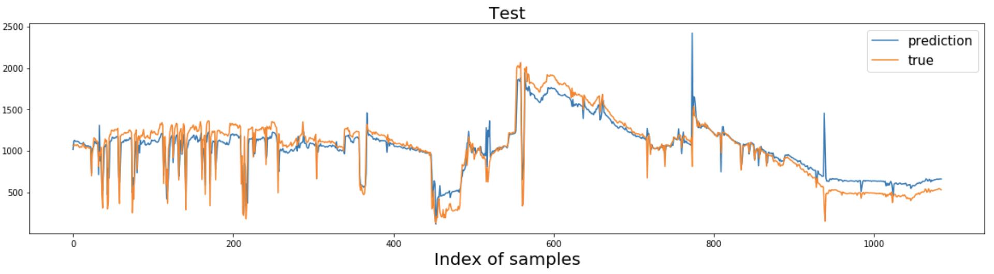
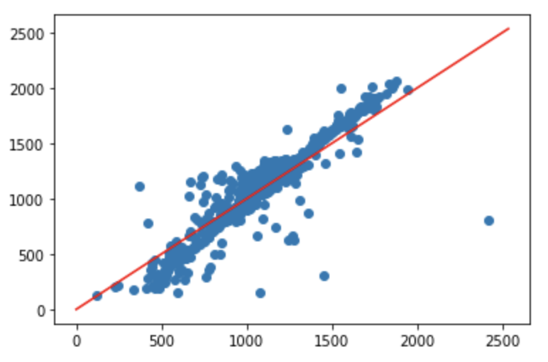
Task #1
For oil
Deploy on well #2

Slide 4
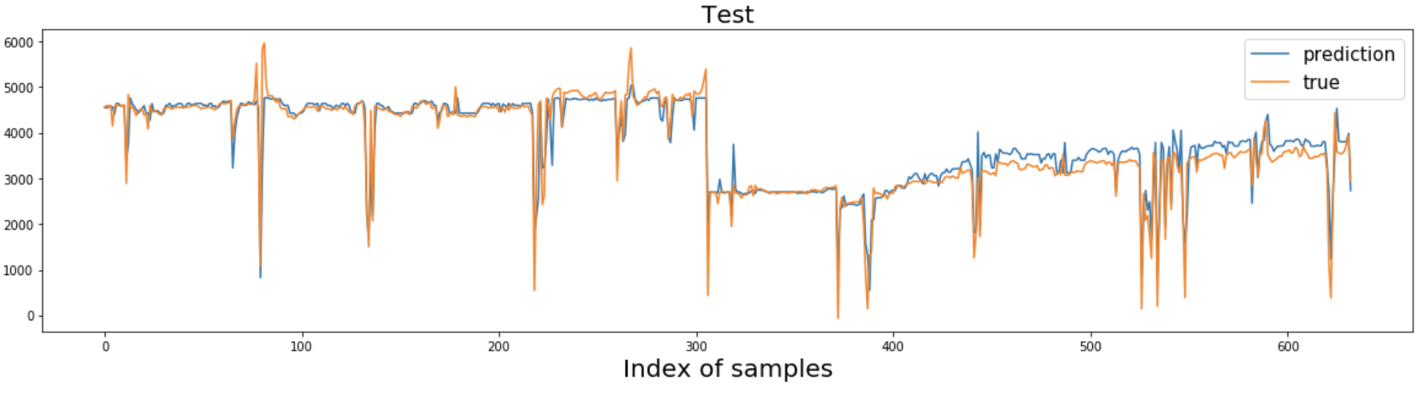
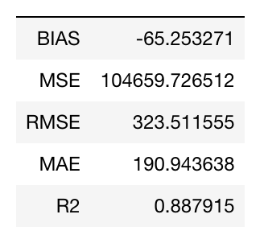
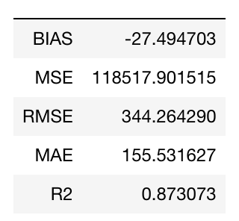
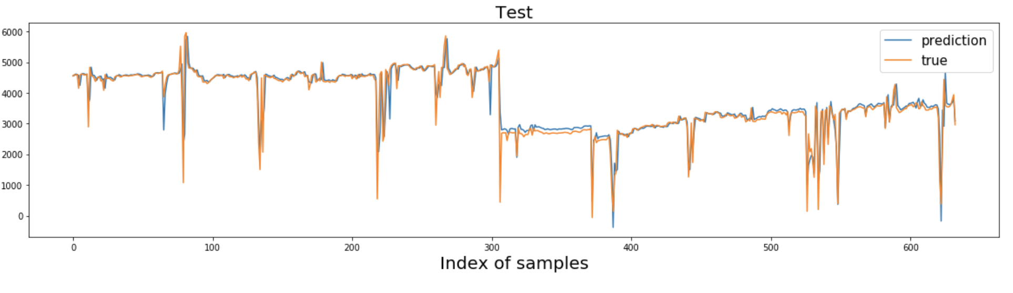
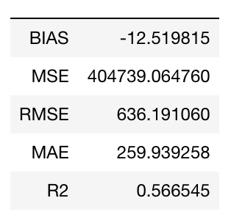
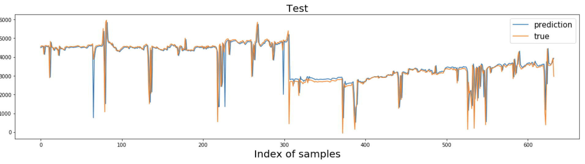
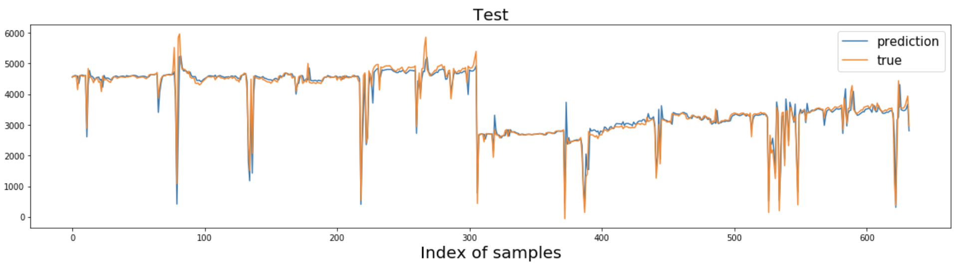
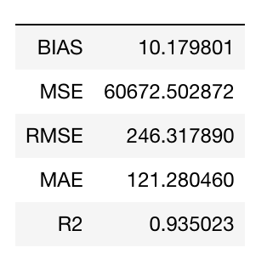
Task #1
For water
RF
{'max_depth': 11, 'max_features': 'auto', 'min_samples_leaf': 4, 'min_samples_split': 2}
{'alpha': 0.3, 'fit_intercept': False, 'l1_ratio': 0.1, 'max_iter': 100}
EN
{'activation': 'relu', 'alpha': 0.1, 'hidden_layer_sizes': 32, 'learning_rate_init': 0.01}
NN
SVR
Best parameter: {'C': 1000.0, 'gamma': 'auto'}

Slide 5
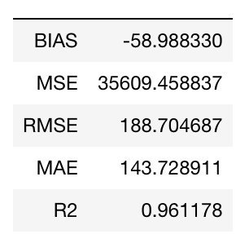
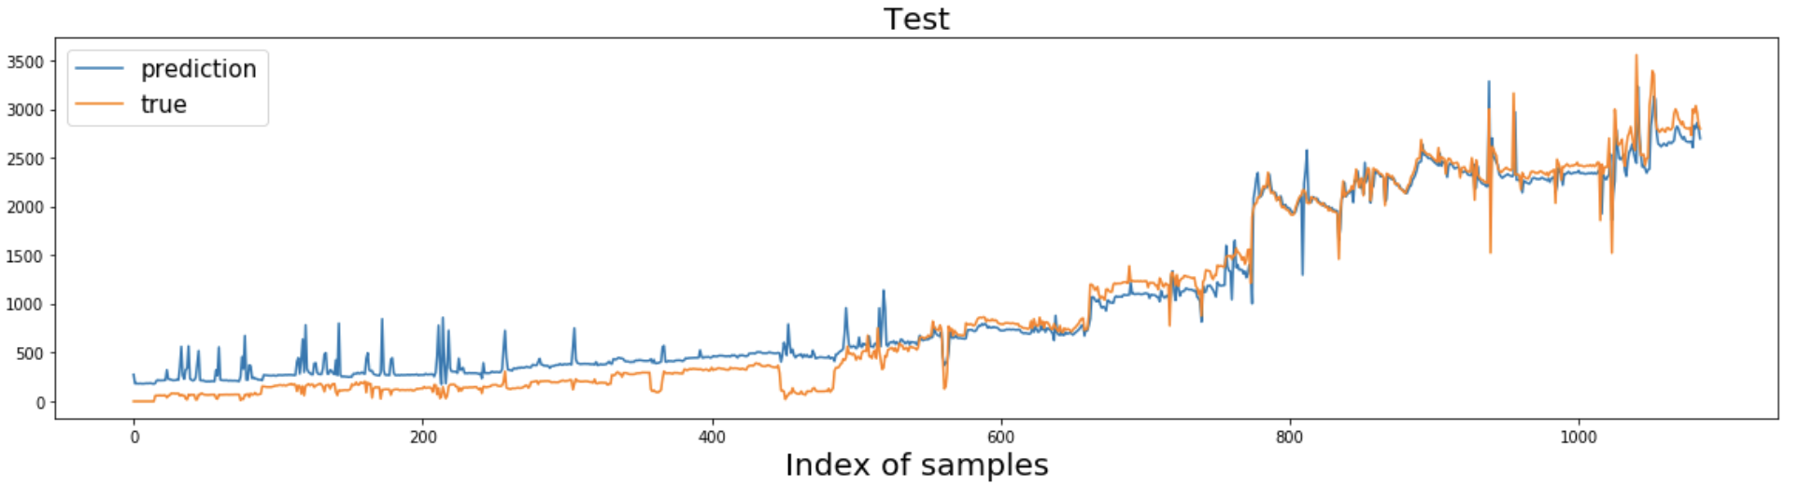
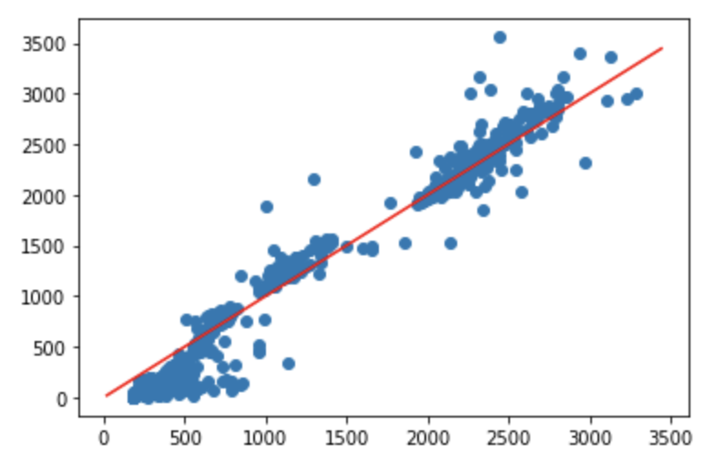
Task #1
For water
Deploy on well #2

Slide 6
Task #2
With model update
With model update
Well #2
Well #2
Determined Model
Determined Model
Well #3
Well #3
Well #4
Well #4
Test data
Part #1
Part #2

Slide 7
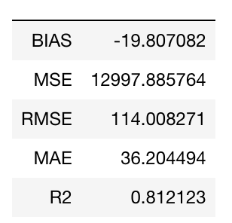
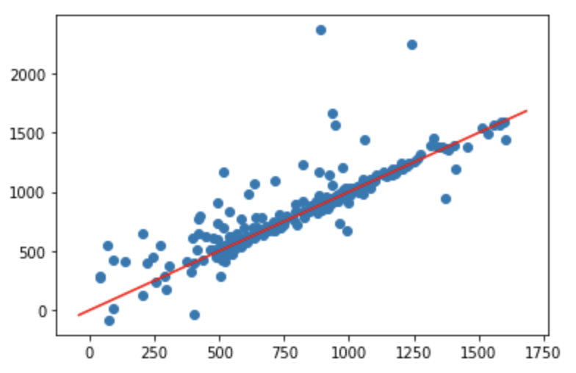
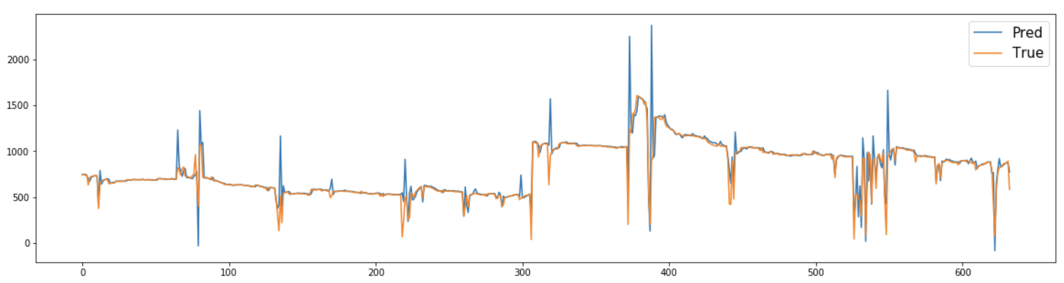
Task #2
Part #1
For oil
With update
Improve
Compared with test in task #1 without update
Forget to generate...

Slide 8
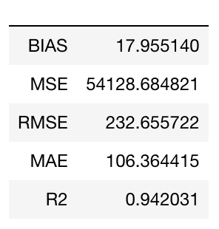
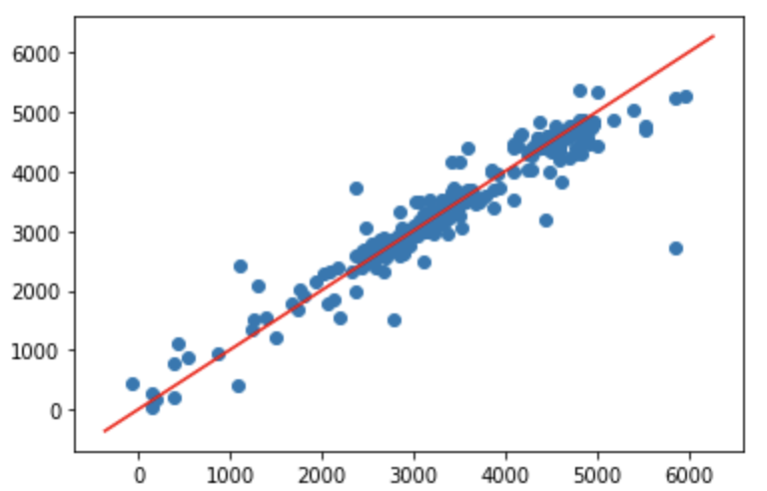
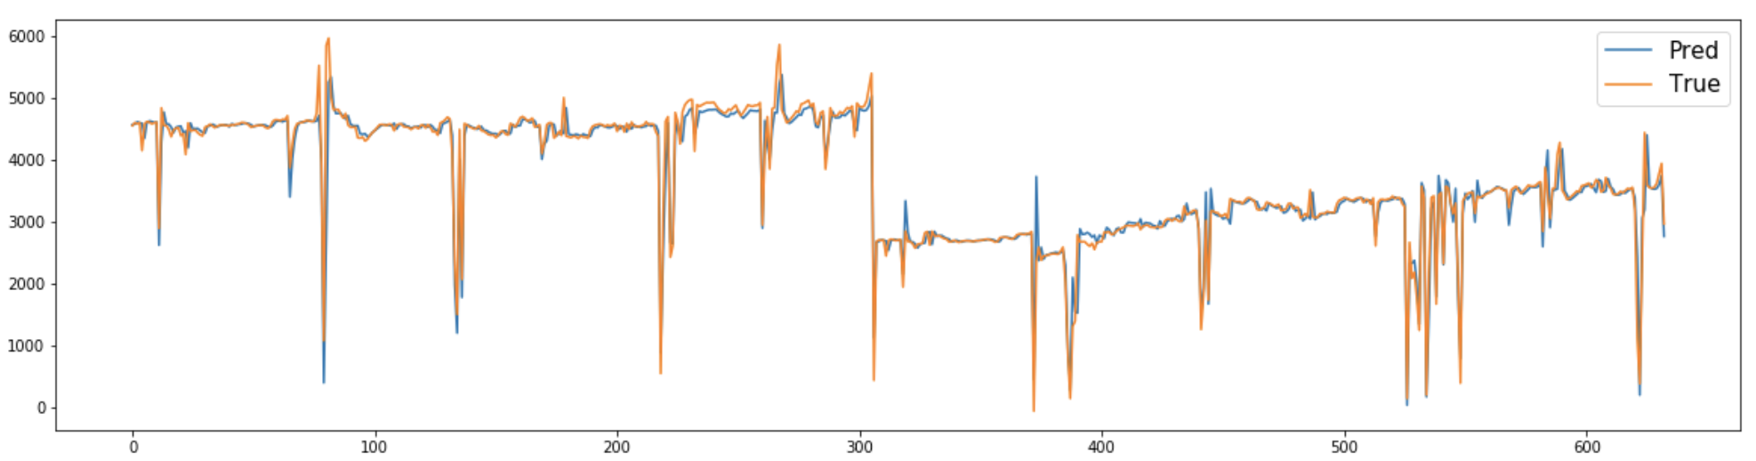
Task #2
Part #1
For water
With update
Compared with test in task #1 without update
Improve
Forget to generate...

Slide 9
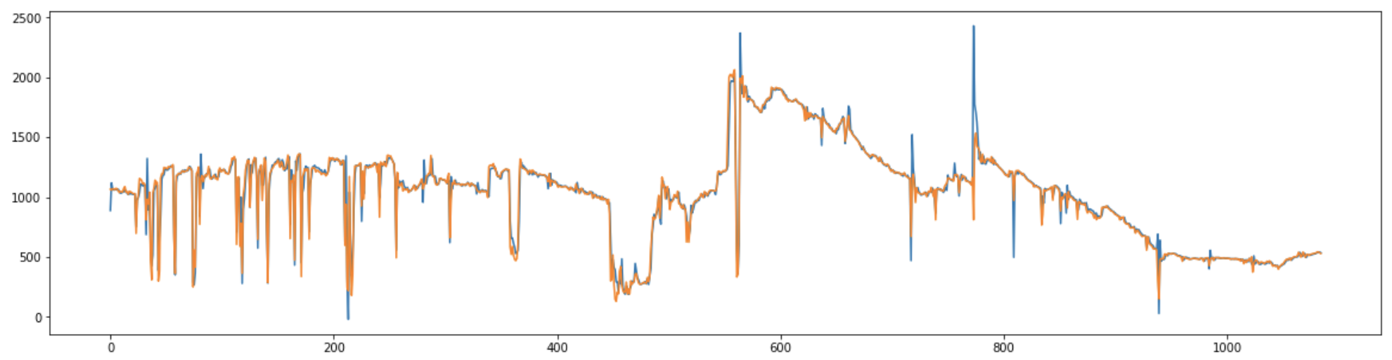
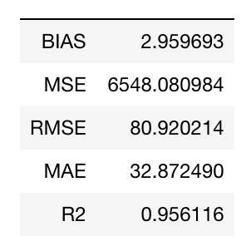
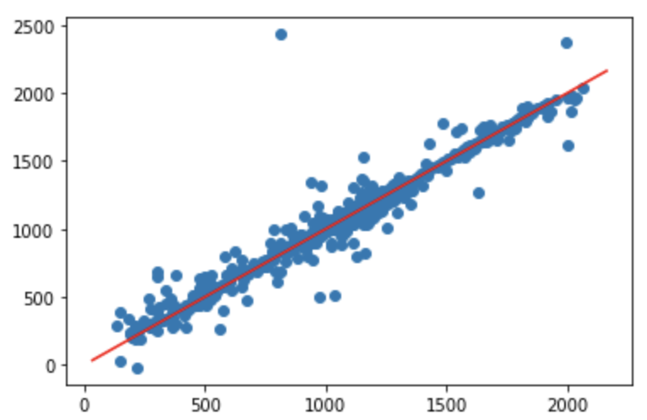
Task #2
Part #2
For oil
With update
Compared with deployment in task #1 without update
Improve greatly

Slide 10
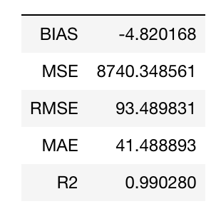
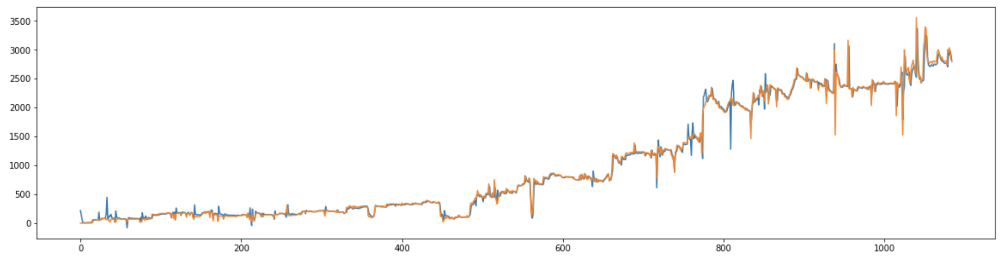
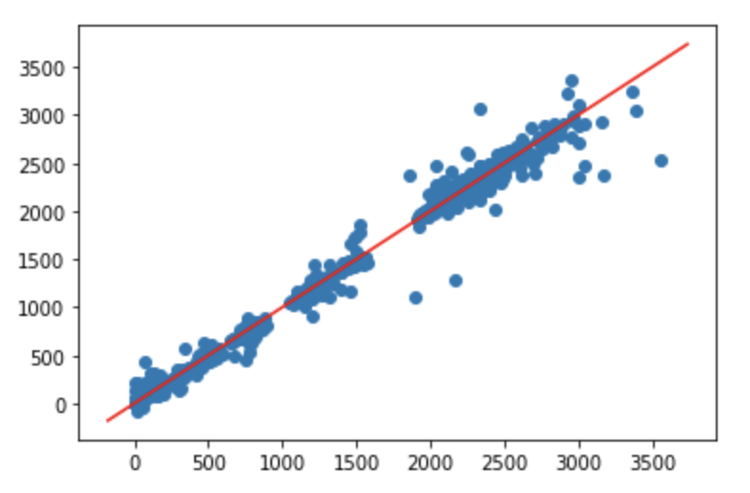
Task #2
Part #2
For water
With update
Compared with deployment in task #1 without update
Improve greatly

